Slide 1


Netflix Stock Profile 2017

Slide 2
AGENDA
The Distribution of Stock Prices in 2017
Netflix’s Earning and Revenue in the last four quarters 2017
The Actual vs Estimated Earnings per share for the four quarters 2017
Comparison of Netflix Stock Price vs the Dow Jones Industrial Average Price in 2017

Slide 3
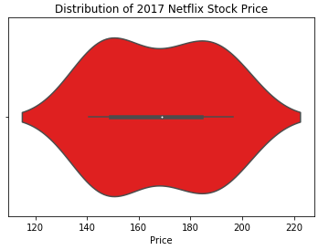
FY2017 Netflix Stock Price
Stock Price Large Volume between 140 to 200
Most Stock Prices fall between 150 to 190 range
Highest Price : 150 , Lowest Price : 120

Slide 4
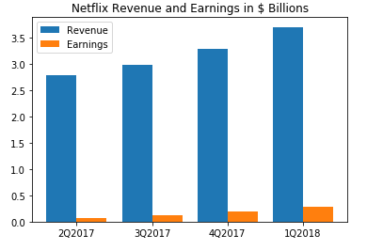
FY2017 Netflix Earning & Revenue
Earning increase linearly from 0.06 to 0.29 Billions
Revenue increase linearly from 2.79 to 3.7 Billions

Slide 5
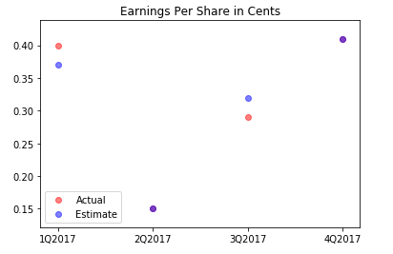
FY2017 Netflix Earning Breakdown
First Quarter
Actual Earning more than Estimated Earning
Second Quarter
Actual Earning equal to Estimated Earning
Third Quarter
Actual Earning less than Estimated Earning
Last Quarter
Actual Earning equal to Estimated Earning

Slide 6
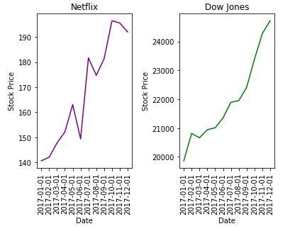
FY2017 Netflix vs Dow Jones Stock
Netflix sink in 2nd Quarter of 2017 but rose marginally in 3rd quarter.
Dow Jones remain average rose with slight drop in 1st quarter of 2017.
Netflix stock are more volatile as compared to Dow Jones.
Netflix price up 26% to 190 and Dow Jones price up 16% to 24000 in 2017

